Slide 1

EVENTFLOW
Event Registration & Attendance Management System
A React Native Mobile Application
Midterm Project · Application Development
Course: BS Information System
Marian Muit
Group Member
John Harvy Baje
Group Member
Dave Archie Magsayo
Group Member
Notes:
Good day. We are Marian Muite, John Harvy Baje, and Dave Archie Magsayo, from BS Information System. Our midterm project is EventFlow - a React Native mobile application for event registration and attendance management.

Slide 2
AGENDA
Presentation Outline
01
Application Title & Group Members
06
Roles & Permissions
02
Background / Problem
07
UI / Screen Overview
03
Objectives
08
System Architecture
04
Target Users
09
Navigation & User Flow
05
Main Features
10
Limitations & Conclusion
EventFlow · Midterm Project · BS Information System
2
Notes:
Here is our presentation outline. We will start with the problem, then the objectives and target users, walk through the features and every screen of the app, and finish with the architecture and conclusion.

Slide 3
PROJECT SCOPE
Project Scope
EventFlow is a React Native mobile application built with Expo to support event management, participant registration, and attendance monitoring.
What the Application Does
Current Implementation
▪ Three roles: Admin / Organizer, Staff / Assistant, Participant / Attendee
▪ Admin creates, edits, and deletes events
▪ Participants browse events and register for their chosen events
▪ Staff verify participants and record attendance via a simulated check-in
▪ Event info, participant lists, attendance views, and report screens
▪ A frontend prototype using sample data and in-memory state
▪ No persistent database storage yet
▪ No real authentication yet
▪ No camera-based QR scanning yet
▪ No functional report export yet
Focus: demonstrating the user interface, navigation, event registration workflow, role-based access, and the attendance-management process.
EventFlow · Midterm Project · BS Information System
3
Notes:
Before we go into the problem, here is our project scope. EventFlow is a React Native mobile application built with Expo that supports event management, participant registration, and attendance monitoring. It provides three roles - Admin / Organizer, Staff / Assistant, and Participant / Attendee. The admin creates, edits and deletes events; participants browse and register; staff verify participants and record attendance through the app's simulated check-in workflow. The app also provides event information, participant lists, attendance views, and report screens. The current build is a frontend prototype using sample data and in-memory state - there is no persistent database, no real authentication, no camera-based QR scanning, and no functional report export yet. Our focus is the user interface, navigation, the registration workflow, role-based access, and the attendance process.

Slide 4
BACKGROUND
The Problem
Campus events are still managed manually — paper sign-in sheets, spreadsheets, and manual head counts.
▪ Long queues at the registration table on event day
▪ Illegible handwritten names and lost sign-in sheets
▪ No way to separate “registered” from “actually attended”
▪ No live count of how many seats are still available
▪ Reports are compiled by hand and take hours
▪ Participants have no proof of registration or check-in
The Need
A single mobile tool where organizers can
create events
, participants can
register
, and attendance is captured with a
QR check-in
— all in real time.
EventFlow · Midterm Project · BS Information System
4
Notes:
Today, campus events still rely on paper. That means long queues, illegible names, lost sheets, and no reliable way to know who actually attended. Reports take hours to compile. EventFlow addresses this with one mobile tool for creating events, registering participants, and checking people in with a QR code.

Slide 5
WHAT WE SET OUT TO DO
Objectives
GENERAL OBJECTIVE
To design and develop a mobile application that manages event registration and attendance using React Native.
SPECIFIC OBJECTIVES
▪ Provide a single, role-aware login for Admin, Staff, and Participant users
▪ Allow organizers to create, view, edit, and delete events
▪ Let participants register for events and prevent duplicate registration
▪ Generate a personal QR code for each participant registration
▪ Verify registration and record attendance through a QR check-in
▪ Prevent duplicate check-ins and surface the attendance record
▪ Produce registration and attendance reports per event
▪ Deliver a clean, consistent, and easy-to-use mobile interface
EventFlow · Midterm Project · BS Information System
5
Notes:
Our general objective was to design and develop a mobile application for event registration and attendance using React Native. Our specific objectives are to provide role-aware access, full event management, participant registration with duplicate prevention, QR generation and scanning, attendance recording, and reports - all through a clean and consistent interface.

Slide 6
WHO USES EVENTFLOW
Target Users
ADMIN / ORGANIZER
STAFF / ASSISTANT
PARTICIPANT / ATTENDEE
Demo account: Dave Archie Magsayo
Demo account: John Harvy Baje
Demo account: Marian Muite
• Creates and manages events
• Views all participants
• Checks in attendees
• Generates reports
• Manages user accounts
• Scans participant QR codes
• Verifies registrations
• Records attendance
• Views the participant list
• Cannot edit or delete events
• Browses and registers for events
• Shows a personal QR code at check-in
• Tracks own registrations
• Cannot see other participants' data
• Cannot access reports
EventFlow · Midterm Project · BS Information System
6
Notes:
EventFlow has three user roles. The Admin creates and manages events, views participants, records attendance, generates reports, and manages accounts. The Staff assistant scans QR codes, verifies registrations, and records attendance. The Participant registers for events and shows a personal QR code at check-in. Each role only sees the tools relevant to them.

Slide 7
WHAT THE APPLICATION DOES
Main Features
1
2
3
4
Role-Based Access
Event Management
Registration
QR Generation
One login, three roles with different permissions
Create, view, edit, and delete events
Participants join events; duplicates blocked
A personal QR code per registration
5
6
7
8
QR Check-In
Attendance Records
Reports
User Management
Scan to verify and record attendance
Present vs registered per event
Per-event registration and attendance summary
View accounts and switch demo roles
EventFlow · Midterm Project · BS Information System
7
Notes:
These are the eight main features: role-based access, event management, participant registration, QR code generation, QR check-in, attendance records, reports, and user management. Each of these will be shown in the screen walkthrough.

Slide 8
WHO CAN DO WHAT
Roles & Permissions
Feature | Admin | Staff | Participant
Create / edit / delete events | ✓ | ✗ | ✗
View event details | ✓ | ✓ | ✓
Register for an event | ✓ | ✗ | ✓
Generate own QR code | ✓ | ✗ | ✓
Scan QR / verify registration | ✓ | ✓ | ✗
Record / view attendance | ✓ | ✓ | ✗
View participant list | ✓ | ✓ | ✗
Generate reports | ✓ | ✗ | ✗
Manage user accounts | ✓ | ✗ | ✗
EventFlow · Midterm Project · BS Information System
8
Notes:
This matrix defines what each role can do. It is enforced in the app by route guards, which redirect a user away from any screen their role is not allowed to open.

Slide 9
02
UI / Screen Overview
Every screen, with a brief description
9

Slide 10
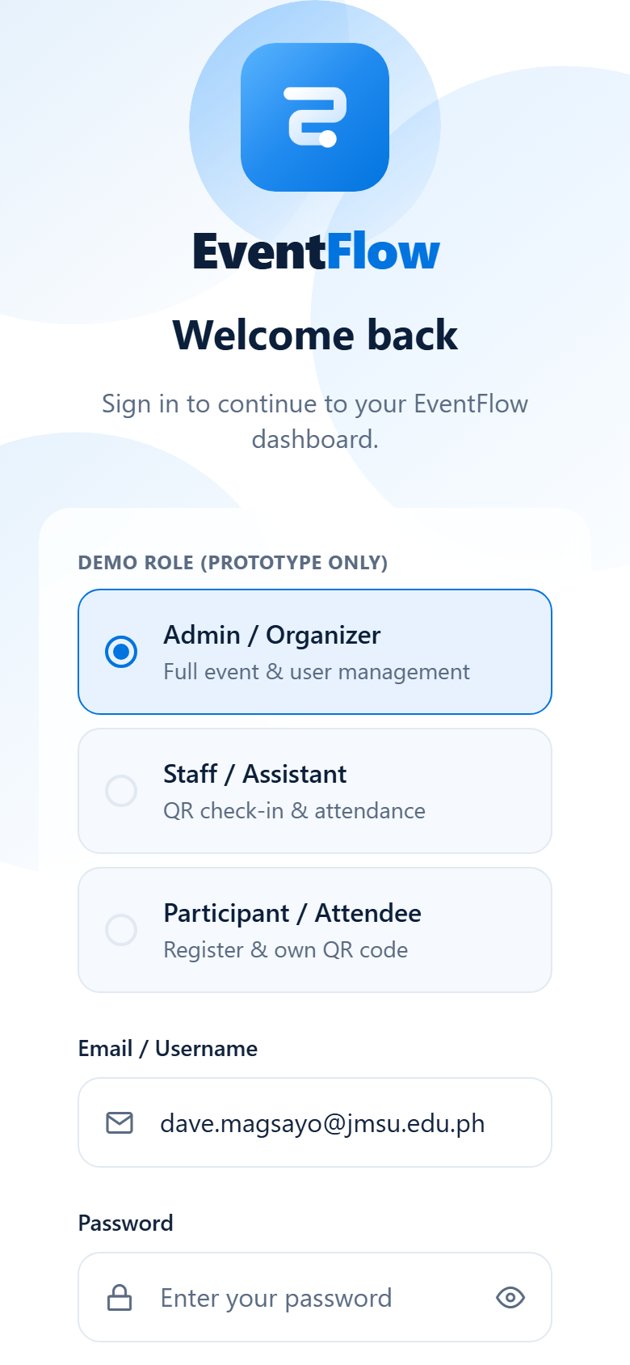
SCREEN 01
Login
▪ One shared login page for all three roles
▪ Email / Username field
▪ Password field with show / hide toggle
▪ Demo role selector — Admin, Staff, Participant
▪ Required-field validation with inline errors
▪ Forgot password link (no backend — informational)
▪ Link to the Sign Up screen
EventFlow · Midterm Project · BS Information System
10
Notes:
The login screen is the entry point. The user picks a demo role, enters any password, and signs in. The selected role decides which screens and tools become available.

Slide 11
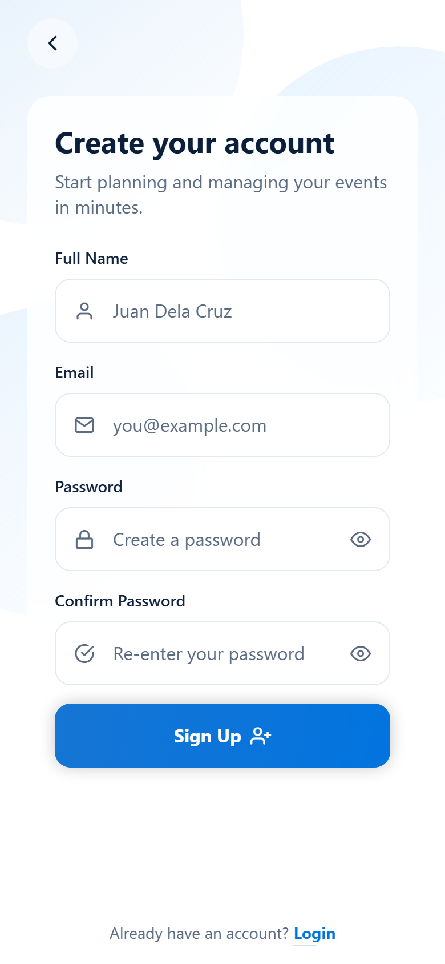
SCREEN 02
Sign Up
▪ Participant self-registration form
▪ Full Name, Email, Password fields
▪ Confirm Password field
▪ Live password-match validation
▪ Error message shown under the Confirm field
▪ Success confirmation returns to Login
EventFlow · Midterm Project · BS Information System
11
Notes:
The sign up screen lets a new participant create an account. The two password fields are compared live, and a mismatch is flagged immediately beneath the Confirm Password field.

Slide 12
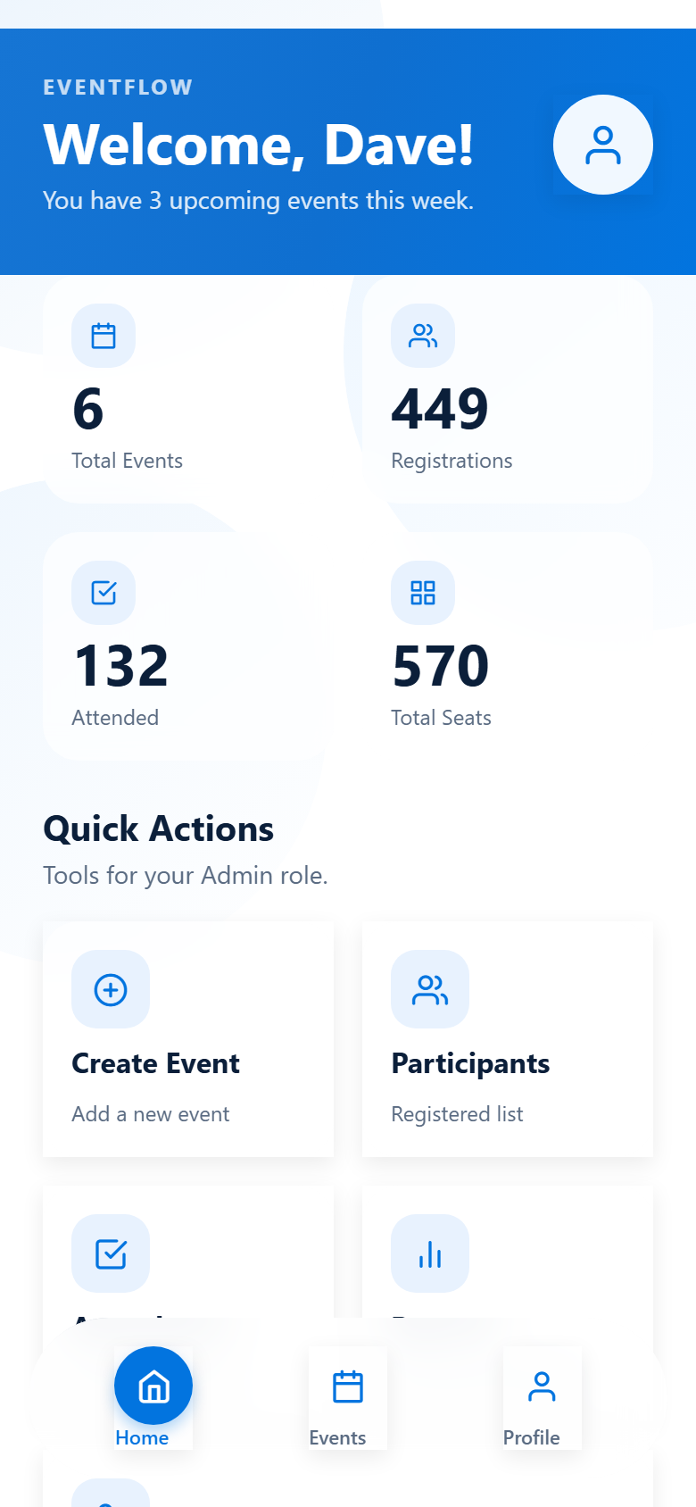
SCREEN 03
Dashboard — Admin
▪ Gradient welcome header with profile avatar
▪ Live summary cards computed from the data
▪ Total Events: 6 · Registrations: 449
▪ Attended: 132 · Total Seats: 570
▪ Five admin quick actions
▪ Create Event, Participants, Attendance, Reports, Users
▪ Upcoming events list with date badges
EventFlow · Midterm Project · BS Information System
12
Notes:
The admin dashboard opens with a gradient welcome header and a profile avatar. The summary cards are computed live from the event data. Only the admin sees the five management shortcuts.

Slide 13
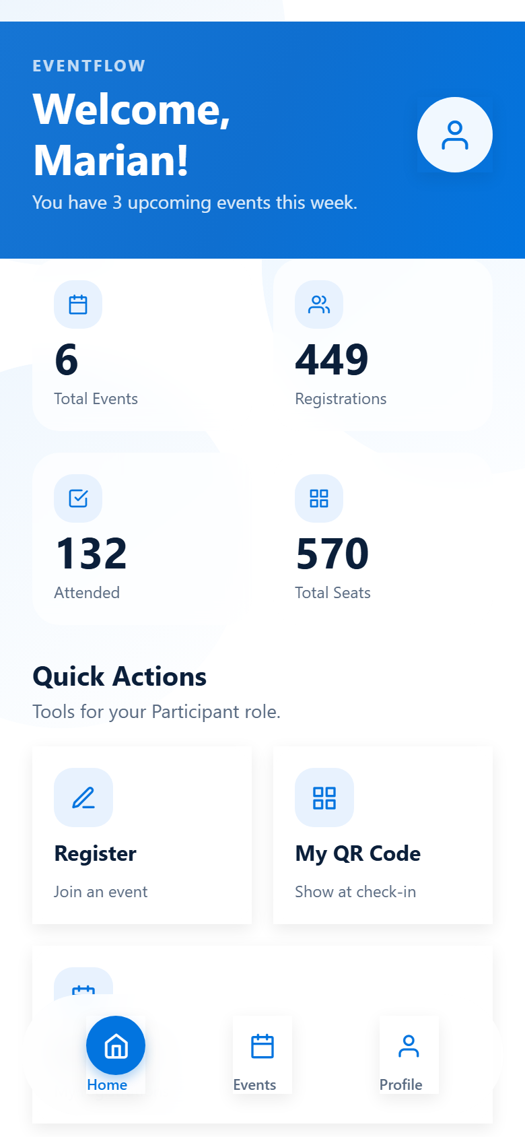
SCREEN 04
Dashboard — Participant
▪ Same layout, different content per role
▪ Personalized welcome message
▪ Three participant quick actions
▪ Register — join an event
▪ My QR Code — show at check-in
▪ My Events — my registrations
▪ No admin tools are visible to this role
EventFlow · Midterm Project · BS Information System
13
Notes:
This is the same dashboard viewed as a Participant. The layout is identical, but the content adapts to the role - the participant only sees Register, My QR Code, and My Events.

Slide 14
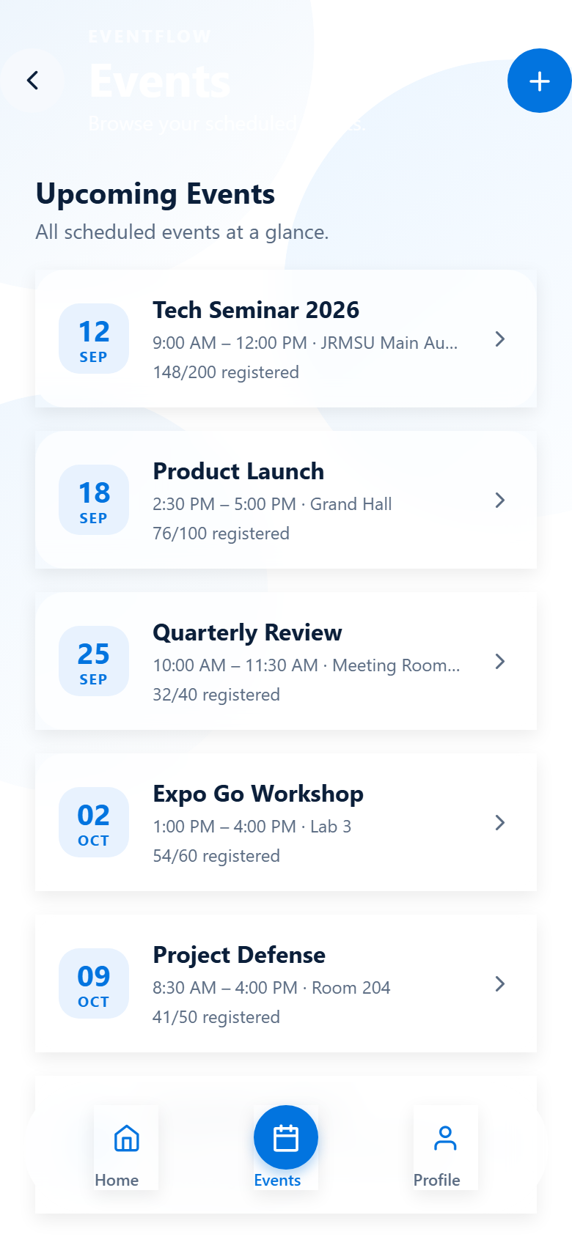
SCREEN 05
Events List
▪ All events with date badges
▪ Venue, time, and organizer per event
▪ Registered count against capacity
▪ Admin sees a create (+) button
▪ Tap any card to open Event Details
▪ Empty state shown when there are no events
EventFlow · Midterm Project · BS Information System
14
Notes:
The events list shows every event with a date badge, venue, and the number registered against capacity. Admins get a create button; everyone can tap a card to open the full event details.

Slide 15
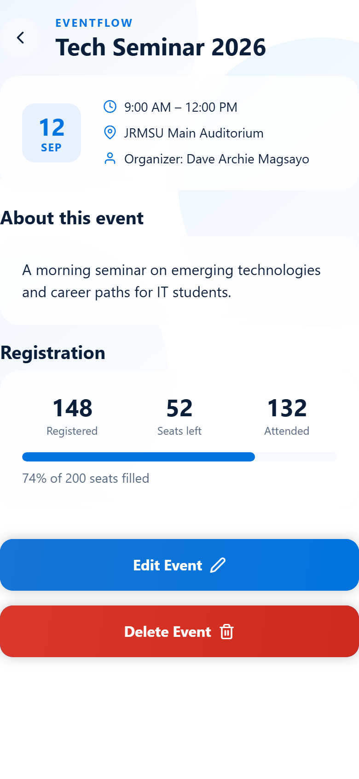
SCREEN 06
Event Details
▪ Full event information
▪ Title, date, time, venue, organizer
▪ Description and registration progress bar
▪ Role-aware actions:
▪ Admin — Edit and Delete event
▪ Participant — Register for this event
▪ Staff — view only
EventFlow · Midterm Project · BS Information System
15
Notes:
Event details shows everything about an event, including a registration progress bar. The available actions change with the role: admin can edit or delete, participants can register, and staff can only view.

Slide 16
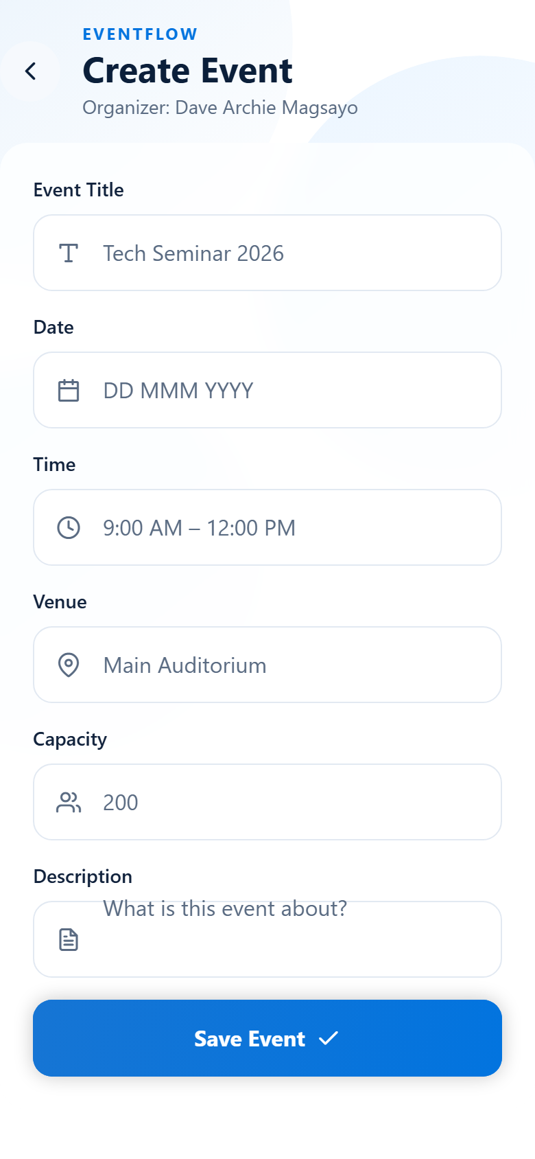
SCREEN 07
Create Event
▪ Admin-only event creation form
▪ Title, Venue, Date, Time fields
▪ Capacity and Description fields
▪ Required-field validation
▪ Capacity must be greater than zero
▪ New event is added to the events store
EventFlow · Midterm Project · BS Information System
16
Notes:
Creating an event is restricted to the admin. The form validates that the required fields are filled and that capacity is greater than zero before the event is saved.

Slide 17
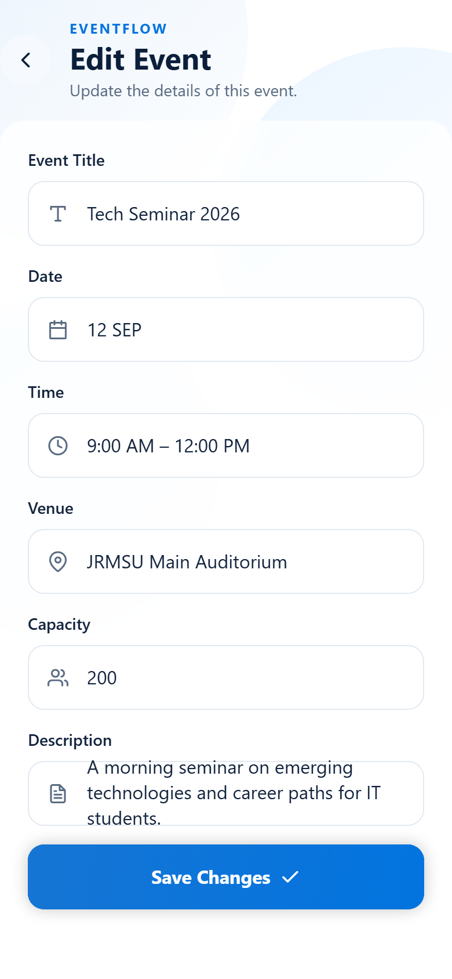
SCREEN 08
Edit Event
▪ Admin-only edit form
▪ Pre-filled with the existing event data
▪ Same validation rules as Create Event
▪ Saving updates the event in the store
▪ Delete is available from Event Details
EventFlow · Midterm Project · BS Information System
17
Notes:
Editing an event reuses the same form as creating one, but pre-filled with the existing values. Saving updates the event everywhere it appears in the app.

Slide 18
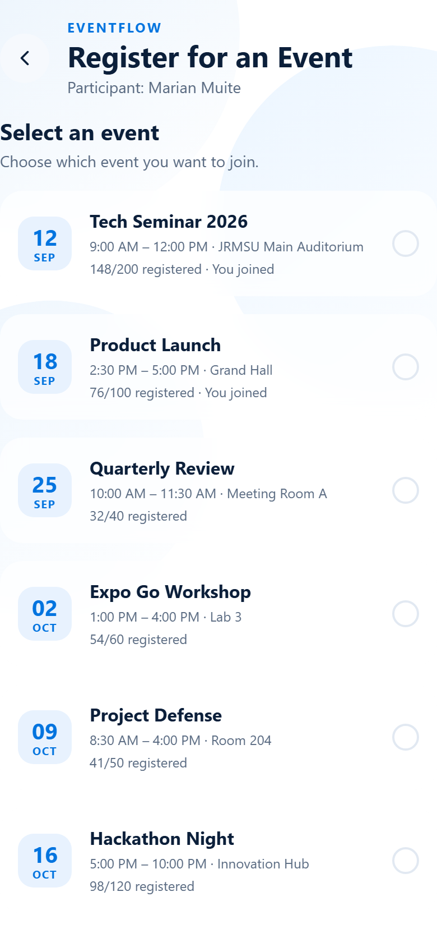
SCREEN 09
Register for an Event
▪ Participant browses open events
▪ Seat availability shown per event
▪ One-tap registration
▪ Duplicate registration is prevented
▪ Registration is stored in memory
EventFlow · Midterm Project · BS Information System
18
Notes:
Participants browse the open events and register with one tap. The app checks existing registrations first, so the same person cannot register twice for the same event.

Slide 19
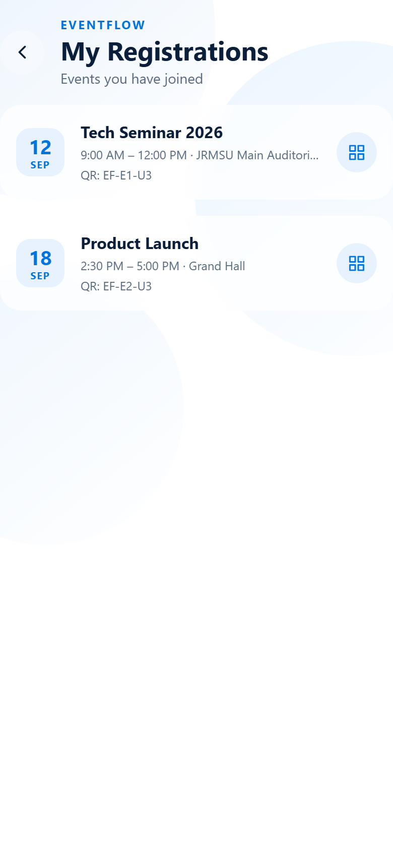
SCREEN 10
My Registrations
▪ The participant's own registrations
▪ Status per event
▪ Registered vs Attended
▪ Link through to the personal QR code
▪ Only the signed-in participant's records
EventFlow · Midterm Project · BS Information System
19
Notes:
My Events lists only the signed-in participant's own registrations, with a clear status for each one showing whether they have already been checked in.

Slide 20
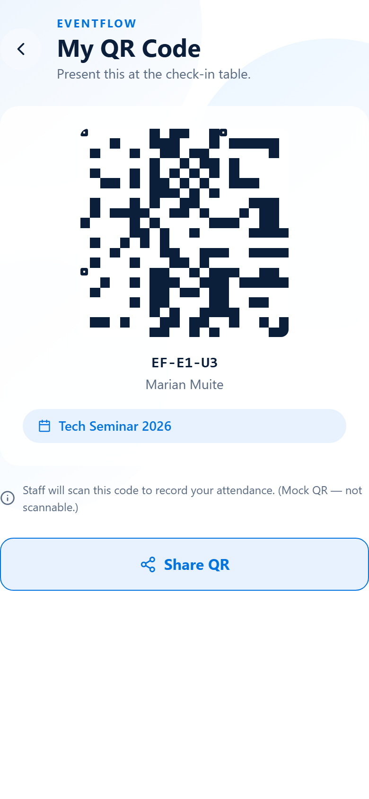
SCREEN 11
My QR Code
▪ The participant's check-in QR code
▪ Tied to one specific registration
▪ Contains the registration reference
▪ Displayed full-screen for easy scanning
▪ Simulated pattern — clearly labeled, not scannable
EventFlow · Midterm Project · BS Information System
20
Notes:
My QR Code shows the participant's own check-in code, tied to a specific registration. In this prototype the pattern is simulated and labeled as such - it is not a scannable QR because the project has no backend.

Slide 21
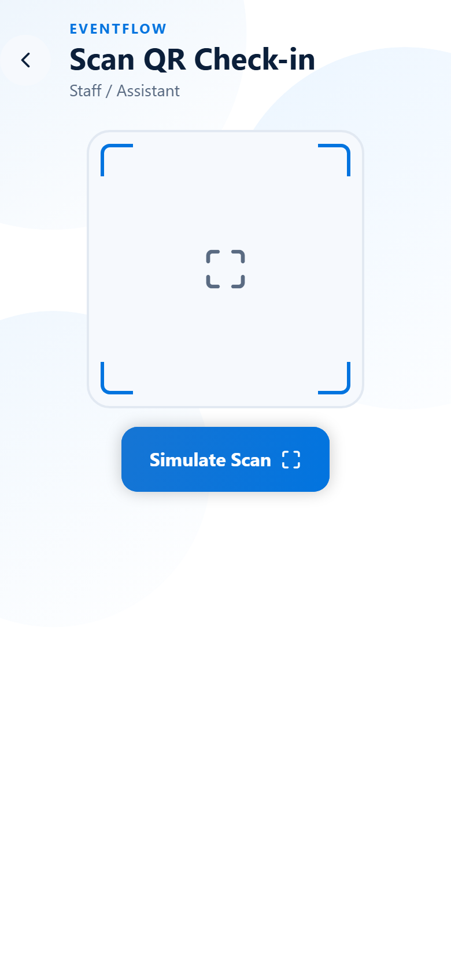
SCREEN 12
Scan QR — Check-In
▪ Staff / Admin check-in scanner
▪ Simulated camera scanning
▪ Verifies the registration
▪ Prevents duplicate check-in
▪ Outcomes:
▪ Valid — checked in successfully
▪ Already checked in — blocked
▪ Not registered — rejected
EventFlow · Midterm Project · BS Information System
21
Notes:
The scanner is used by staff and admin at the venue. It verifies the registration, checks the participant in, and blocks anyone who has already been checked in or is not registered.

Slide 22
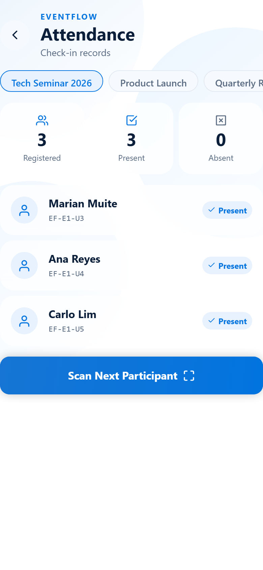
SCREEN 13
Attendance
▪ Check-in records per event
▪ Present count against registered count
▪ Per-participant check-in state
▪ Duplicate check-in is prevented
▪ Visible to Admin and Staff only
EventFlow · Midterm Project · BS Information System
22
Notes:
Attendance shows the check-in records for each event, comparing how many registered against how many actually attended. Only admin and staff can see this screen.

Slide 23
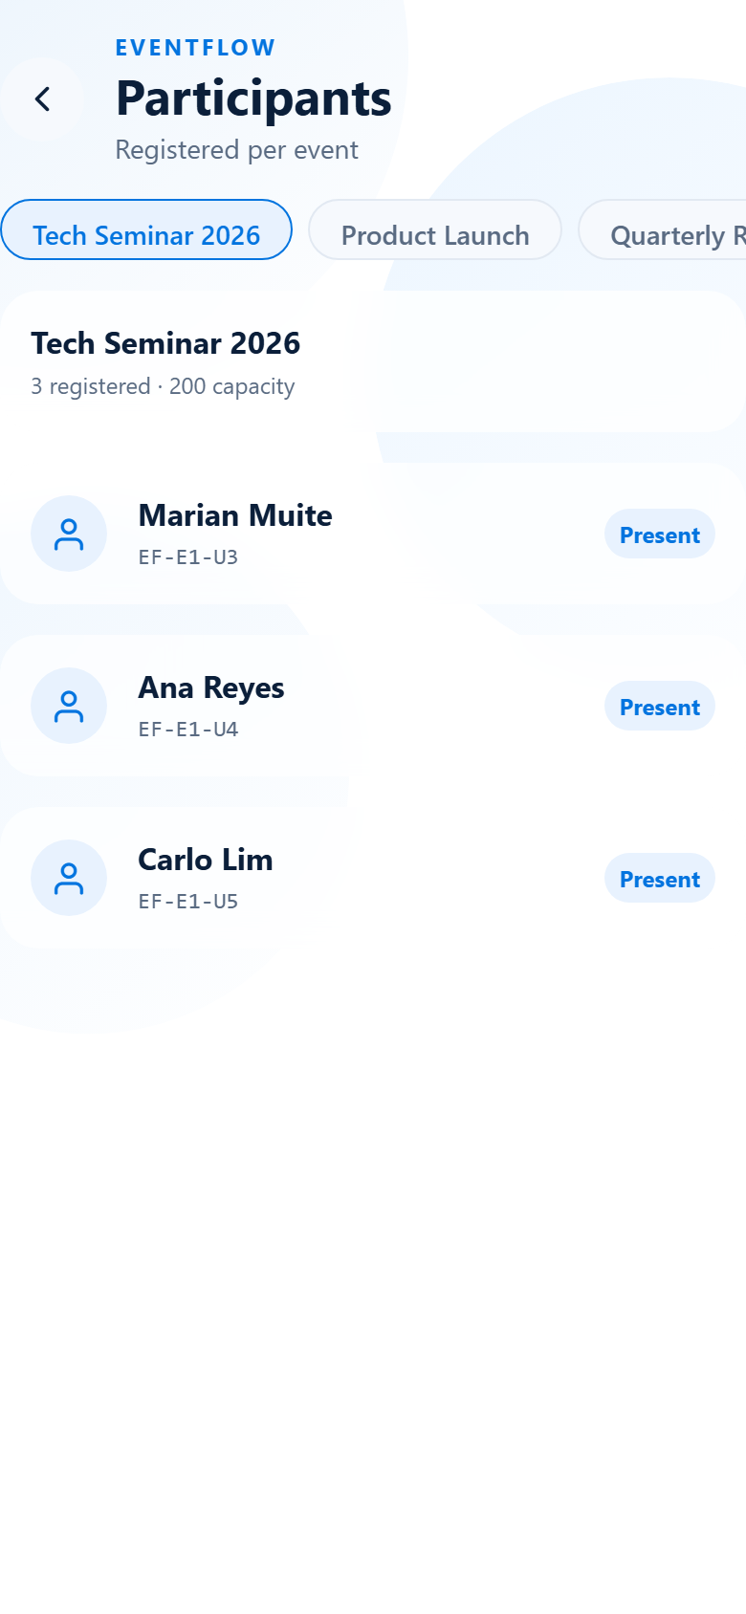
SCREEN 14
Participants
▪ Registered participants per event
▪ Name, email, and role per record
▪ Check-in status indicator
▪ Sample data, clearly for demonstration
▪ Visible to Admin and Staff only
EventFlow · Midterm Project · BS Information System
23
Notes:
The participants screen lists everyone registered to an event, with their details and check-in status. Participants cannot view this list, so one attendee never sees another's information.

Slide 24
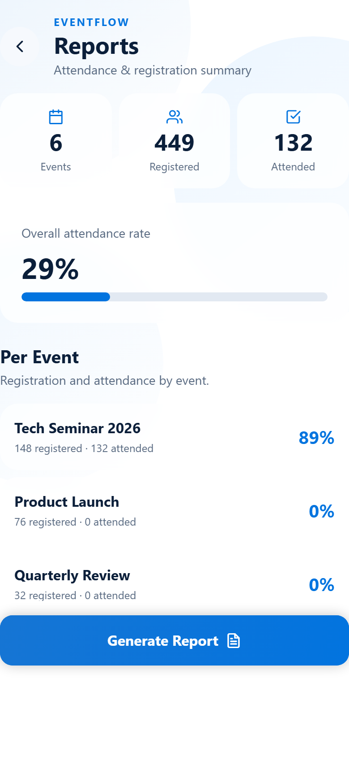
SCREEN 15
Reports
▪ Registration and attendance summary
▪ Per-event statistics
▪ Derived from the live event data
▪ Admin only
▪ Export action shows a notice (no backend)
EventFlow · Midterm Project · BS Information System
24
Notes:
Reports summarizes registration and attendance per event, calculated from the same live data used across the app. It is admin-only. The export button currently shows a notice instead of producing a file, because there is no backend in this prototype.

Slide 25
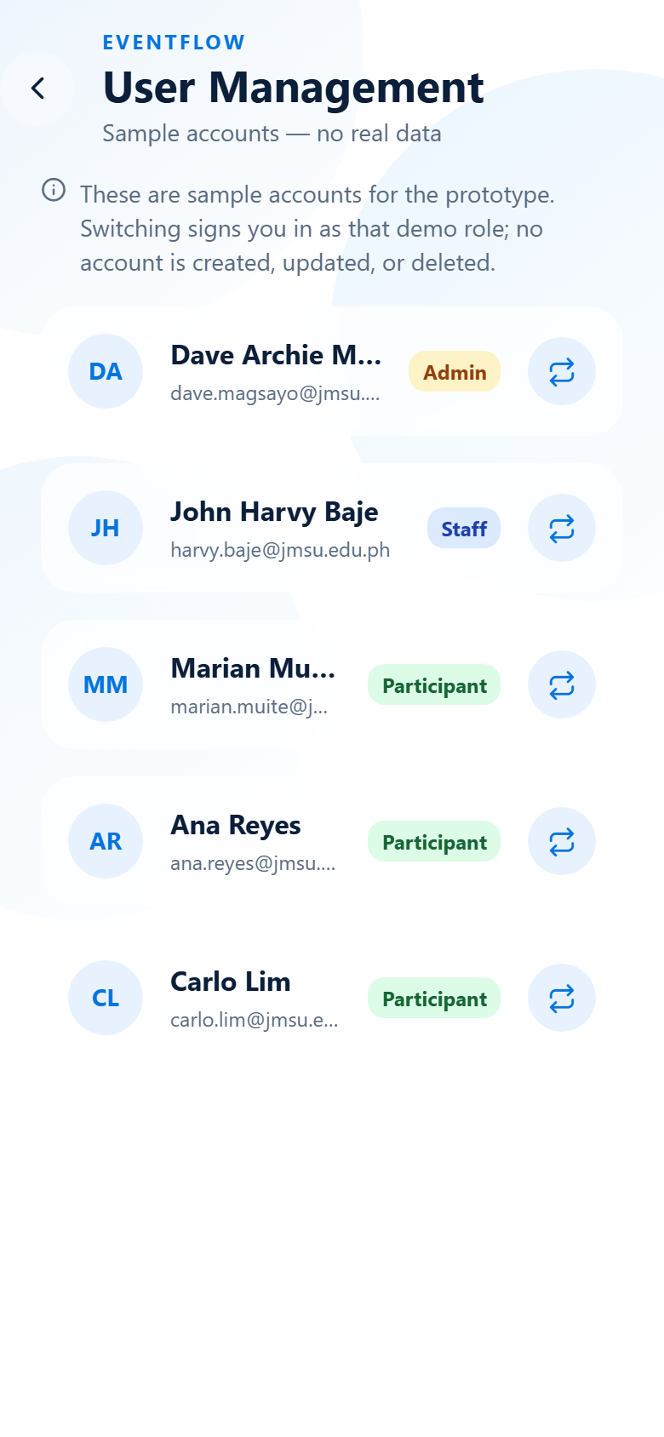
SCREEN 16
User Management
▪ List of user accounts with roles
▪ Admin, Staff, and Participant accounts
▪ Shows the currently signed-in user
▪ Demo role switching for testing
▪ Admin only
EventFlow · Midterm Project · BS Information System
25
Notes:
User management lists the demo accounts with their roles and marks the currently signed-in user. It also allows switching the demo role, which makes it easy to demonstrate all three perspectives during this presentation.

Slide 26
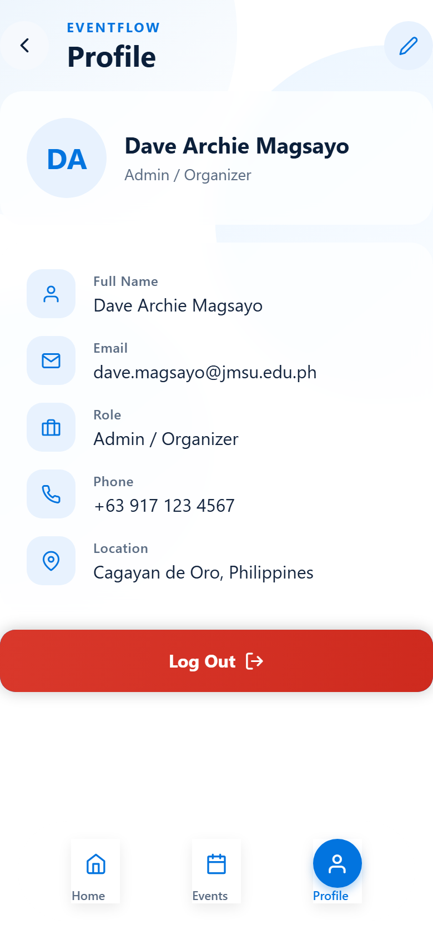
SCREEN 17
Profile
▪ View the signed-in user's account details
▪ Edit mode to update the profile
▪ Role and email displayed
▪ Log Out button (destructive styling)
▪ Log Out returns to the Login screen
EventFlow · Midterm Project · BS Information System
26
Notes:
The profile screen shows the signed-in user's details with an edit mode. The Log Out button is styled as a destructive action and returns the user to the login screen.

Slide 27
HOW IT IS BUILT
System Architecture
Technology Stack
State Management
Structure
▪ Expo SDK 57 · React Native 0.86
▪ React 19 · TypeScript (strict)
▪ Expo Router — file-based routing
▪ React Native Reanimated 4
▪ Expo Linear Gradient · Blur
▪ Runs on Android, iOS, and Web
▪ React Context + hooks
▪ DemoSessionContext — role session
▪ EventsProvider — event store
▪ RegistrationsProvider — registrations
▪ In-memory only (no backend)
▪ Resets on refresh, by design
▪ src/app/ — 17 screens (routes)
▪ src/components/ — 9 shared UI parts
▪ src/context/ — 3 providers
▪ src/constants/ — theme + permissions
▪ src/hooks/ — responsive + route guard
▪ src/styles/ — separated styles
EventFlow · Midterm Project · BS Information System
27
Notes:
The app is built with Expo and React Native using TypeScript. Navigation is file-based with Expo Router. Application state is held in React Context, so events and registrations persist while the app is open but reset on refresh, because there is no backend.

Slide 28
VERIFICATION
Code Quality & Project Organization
Check | Command / Detail | Result
TypeScript type check | npx tsc --noEmit | Pass
Linting | npx expo lint | Pass
Screens (routes) | src/app/*.tsx | 17 screens
Shared components | src/components/*.tsx | 9 components
State providers | src/context/*.tsx | 3 providers
Design tokens | src/constants/theme.ts | Single source
Permission matrix | src/constants/permissions.ts | Code-enforced
Styles | src/styles/*.styles.ts | Separated
EventFlow · Midterm Project · BS Information System
28
Notes:
Both the TypeScript type checker and the linter pass cleanly. Styles are separated from the screens, the design system lives in one theme file, and the permission matrix is enforced in code.

Slide 29
HOW THE USER MOVES THROUGH THE APP
Navigation & User Flow
Login
Dashboard
Events
Event Detail
Check-In
Reports
›
›
›
›
›
Pick a role, sign in
Role-aware landing
Browse all events
View / Edit / Register
QR scan → Attendance
Summary per event
▪ Expo Router file-based routing — every file in src/app/ is a screen
▪ Bottom navigation changes with the role
▪ Admin & Participant: Home / Events / Profile
▪ Staff: Home / Scan / Profile
▪ Route guards redirect users away from screens their role cannot access
▪ No session at all → redirected to Login
▪ Log Out clears the session and returns to Login
EventFlow · Midterm Project · BS Information System
29
Notes:
Navigation is file-based using Expo Router. The bottom navigation bar adapts to the role - staff get a Scan shortcut instead of Events. Route guards protect every screen: if a user tries to open a screen their role is not allowed to use, they are redirected back to their dashboard, and if there is no session at all they are sent to login.

Slide 30
WHAT WE WILL SHOW
Live Demonstration Plan
1 — Admin
2 — Participant
3 — Staff
▪ Log in as Admin
▪ Show dashboard stats
▪ Create a new event
▪ Edit and delete an event
▪ Show participants and reports
▪ Show user management
▪ Log out, log in as Participant
▪ Browse the events list
▪ Register for an event
▪ Try registering twice (blocked)
▪ Open My QR Code
▪ Log out, log in as Staff
▪ Open the Scan screen
▪ Check in a valid registration
▪ Try a duplicate check-in (blocked)
▪ Show the attendance record
EventFlow · Midterm Project · BS Information System
30
Notes:
Our demonstration will follow three passes - one per role. First the admin creates and manages an event. Then a participant registers and shows their QR code. Finally, staff scans the QR code to check the participant in, and we show that a duplicate check-in is blocked.

Slide 31
STATED HONESTLY
Prototype Limitations
No backend or database
All data is mock and in-memory; everything resets on refresh.
No real authentication
The role selector is a demo control, not identity verification.
Guards are not security
Frontend route guards can be bypassed; they only shape the demo.
QR is simulated
The QR pattern is not scannable and the scanner uses no camera.
No file export
The report export button shows a notice, not a real file.
Dynamic dates
Event dates are free text — there is no date picker in scope.
EventFlow · Midterm Project · BS Information System
31
Notes:
We want to be upfront about the scope. This is a frontend UI prototype: there is no backend, so mock data resets on refresh. The role selector is a demo control rather than real authentication, the route guards are not a security boundary, the QR code is simulated, and report export does not produce a real file. We documented these limitations deliberately.

Slide 32
WRAPPING UP
Conclusion
EventFlow delivers a complete, role-aware mobile interface for event registration and attendance management.
What we achieved
Why it matters
✓ All 17 screens built and connected
✓ Three roles with enforced permissions
✓ Full event lifecycle: create, edit, delete
✓ Registration with duplicate prevention
✓ QR check-in with attendance tracking
✓ Reports and user management
✓ Consistent, responsive UI design
✓ Replaces paper sign-in sheets
✓ Removes long registration queues
✓ Gives a reliable attendance record
✓ Participants keep proof of check-in
✓ Organizers get instant summaries
✓ One app for three user roles
EventFlow · Midterm Project · BS Information System
32
Notes:
In conclusion, EventFlow delivers a complete and consistent mobile interface for event registration and attendance. We built all 17 screens, three roles with enforced permissions, and the full event lifecycle including QR check-in. It replaces paper sign-in sheets with a reliable digital record that both organizers and participants can trust.

Slide 33
EF
Thank You
Questions & Answers
EventFlow
BS Information System
Marian Muit · John Harvy Baje · Dave Archie Magsayo
Notes:
That concludes our presentation. Thank you for listening - we are ready for your questions.

